Slide 1
Azure Cloud Native Operating Model - Alwyn lobo Chief architect MCMS public cloud offerings
8 April 2022

Slide 2


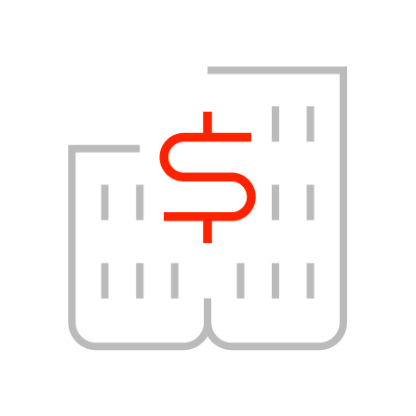
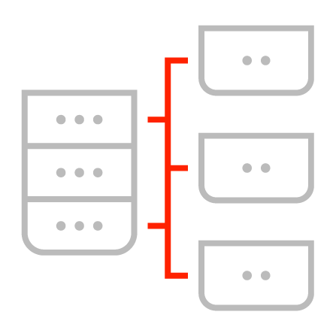




Next-generation public cloud managed services
Design Principles
Key Service Highlights
Pay as you go model
Dedicated squad delivery model
Cloud Native and existing tools
Add-on services
Cloud Native Approach
Automation Orientation
Modular
Pricing
API Integration
Standardization with flexibility through add-on packages
Comprehensive Support for Public Cloud Services
Manage full lifecycle
Certified Partner, Certified Skills
Cognitive Analytics and Delivery Automation
Service Tiers
Regulatory
Compliance
Optional
Add on Packages
Support for full scope of public cloud catalog and services. Catalogue based, modular services across the landscape
MCMS delivers key capabilities to provision, manage and optimize customer’s public cloud environments and platform
Partner to major public cloud providers. Pool of experienced certified resources across relevant skills and levels
IBM’s powerful analytics and automation engine provide auto-detect and auto-resolve capabilities ensuring consistent quality of service
Base
Standard Operations

Slide 3
Cloud Management use cases
Manage Use case | Native Service/Tool
Service health Monitoring | Azure Service Health
IaaS and PaaS Services monitoring | Azure Monitor/Datadog
Backup failure monitoring | Log Analytics + Azure Alerting
Application Monitoring | Log Analytics + Application Insights
Container platform monitoring ( AKS, ARO) | Prometheus
Event Management | Netcool Operations Insight (NOI)
Inventory View | Azure resource view
Continuous compliance | Microsoft Defender for Cloud + MCMS assets
Governance and Policy | Azure Policy, Defender for Cloud
Backup | Backup Center, Recovery Vault
Patching | Update Manager + CACAF assets
Log Management | Azure Log Analytics workspace
Manage Use case | Native Service/Tool
Provisioning and Configuration Mgmt | Terraform/ARM Template + Azure DevOps
Onboarding and Make Manage | MCMS automation assets
Day-2 Operations Automation | MCMS automation assets
Consumption monitoring and reporting | Azure Advisor, Cost Management
Resource utilization optimization | Azure Advisor + Datadog
Dashboards | Power BI
Service Management | ServiceNow
Discovery and CMDB Sync | SNOW ITOM
SIEM | Azure Sentinel
Vulnerability Mgmt | Azure Integrated vulnerability assessment solution
Identity and Access Mgmt | Azure AD Premium Edition
Privileged Identity Management | Azure AD Premium Edition

Slide 4











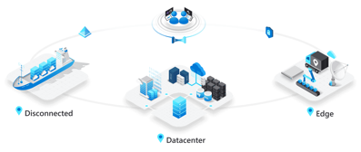








Kyndryl’s Cloud Services for Azure Ecosystem
Effectively build and manage Azure environments irrespective of where they are deployed
Kyndryl Operations
Onboarding
Management
Incident
Management
Problem
Management
Change
Management
Service
Request
Patch
Management
Backup and Restore
Management
Compliance
Management
Provisioning
Management
2
Cloud native
Operating Model
Monitor
Manage, govern & optimize
Industry standards, regulation(s) & best practices
Azure Services
4
Azure
monitor
Service
health
Azure
policy
Azure
compliance
Azure Public Cloud
Azure
lighthouse
Discover
Azure logs
analytics
Azure
alerts
Workbooks
Azure
advisor
API
5
KCMP
AIOPS
1
Azure Stack ecosystem
Azure
arc
Update
mgmt
Defender
for cloud
Deploy
Workflow
Azure key
vault
Backup
mgmt
Azure
automation
Kyndryl
CACF
3
Azure
Secure center
1
Seamless & fast pluggable operations
2
Secured and controlled onboarding
3
Automated, standardized and secure deployments
4
Immutable & CIS benchmark compliant
5
Manage, Govern &Optimize
Notes:
Deliver Seamless operations across hybrid deployments by leveraging combination of Azure native & 3rd party tools
Easier and faster onboarding through centralized access and policy governance through Azure Lighthouse
Standardized deployments templates for faster provisioning using IaC principles
Maintain CIS compliance posture across Azure hybrid aligned leveraging Azure Security Centre
Transform Operations, built on Kyndryl Cloud Operating Model and Azure CAF
Key Kyndryl Differentiators:
Transform Cloud Native Operating Model
Leverage existing automation framework and library
Advantage of pre integrated cloud management stack that works across Azure Ecosystem

Slide 5

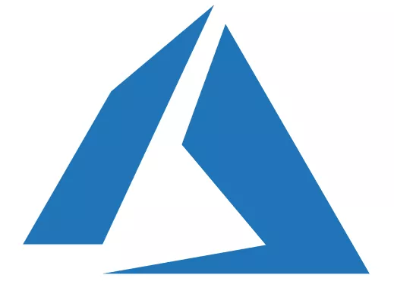















Proposed solution architecture for Azure cloud native operating model
Multi-cloud Management Platform
MCMS Azure Management Subscription
Customer-1 Subscription
Sservice catalog
Kyndryl Tenant-1 Hub VNET
Lighthouse
Lighthouse
Orchestration
Client -1 Hub VNET
Provisioning
Kyndryl Mgmt Hub VNET
Ansible
Jump
WSUS
Server
Proxy
Server
Discovery
Peering over private network
Internet
IPC
FW and VPN GW
Kyndryl Tenant-2 Hub VNET
CMDB
Customer-2 Subscription
Ansible Tower
Ansible
Jump
WSUS
Server
Proxy
Server
Lighthouse
Peering over private network
Client -2 Hub VNET
MCMS Tools POD
Azure Native tools
Monitor
Automation
Diagnostic
Logs
Recovery Vault
Activity Log
NW Watcher
Policy
Advisor
Netcool NOI
Faster Transition. From 3 months to 1 month
No S2S VPN is needed.
Jump host and relay servers are hosted on Kyndryl Mgmt subscription. Cost benefit to the client
Kyndryl users IAM is managed centrally using LH. Removes the delay getting access to client env.

Slide 6
Thank you
8 April 2022
6

